Slide 1
ADVANCED DATA STRUCTURE I & II
GROUP MEMBERS (G3)
MBAKOP RAPHAEL G (LEADER)
NGUIMFACK MERVIC C
AGHABONG JUDE
SUPERVISED BY:
MR TEKOH PALMA

Slide 2
ARRAYS!
WHAT IS AN ARRAY ?

Slide 3
TYPES OF ARRAYS
One-Dimensional Arrays
Multi-Dimensional Arrays ( includes 2 Dimensional and
3 Dimensional Arrays )

Slide 4
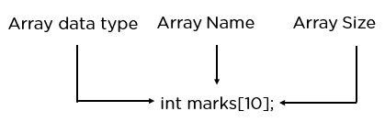
DECLARATION OF AN ARRAY

Slide 5
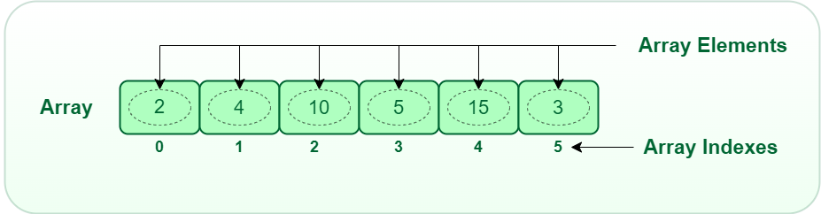
DECLARATION OF AN ARRAY

Slide 6
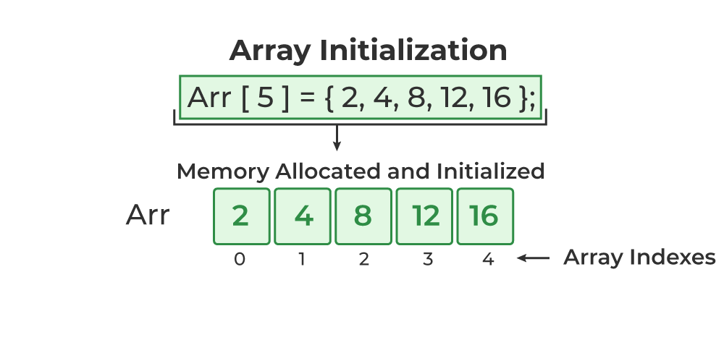
INITIALIZATION OF 1D ARRAY

Slide 7




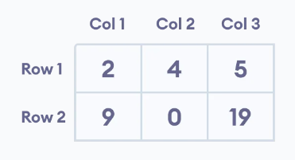
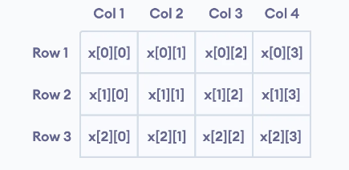
INITIALIZATION OF A 2D AND 3D ARRAYS

Slide 8
APPLICATION OF ARRAYS
Storing and accessing data
Sorting
Searching
Insertion
Matrices
Graphs etc

Slide 9
ADVANTAGES OF ARRAYS
Easy to implement
Efficient access to elements
Versatility
Fast data retrieval
Memory efficiency

Slide 10
DISADVANTAGES OF ARRAYS
Fixed size
Memory allocation issues
Wasted space
Limited data type support
Insertion and deletion issues

Slide 11
SOME COMPLEXITIES OF ARRAY OPERATIONS
Merge sort:
Time complexity: O(nlogn)
Space complexity: O(n)
Linear search
Time Complexity: O(n)
Space Complxity: O(1) etc

Slide 12
IMPLEMENTATION OF 1D, 2D AND 3D OF ARRAYS
For 1D array we used LINEAR SEARCH
For 2D array we used MATRICES
For 3D array we used MATRICES
View our code implementation!

Slide 13
BINARY TREES
A binary tree is a sort of tree data structure in which each node has a maximum of two offspring, known as the left child and the right child.

Slide 14
OPERATION OF BINARY TREES
Insertion
Deletion
Searching
Traversal
Measurement of Height etc

Slide 15
APPLICATION OF BINARY TREES
Binary Search Trees (BST)
Expression Trees
Huffman Coding
Decision Trees
File System Indexing
Game Trees
Syntax Tree Parsing

Slide 16
PROPERTIES OF BINARY TREES
Node Structure
Root Node
Parent and child Nodes
Leaf Nodes­­
Internal Nodes
Subtrees etc

Slide 17
BINARY SEARCH TREE
It is a node has at most two children, and the left child contains values less than the node, while the right child contains values greater than the node.

Slide 18
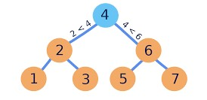
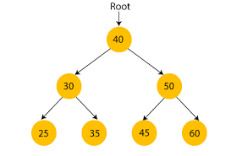
EXAMPLE OF BST
View our implementation!

Slide 19
ADVANTAGE & DISADVANTAGE OF BST
Efficient Search
Ordered Structure
Sensitivity to Input Order
Lack of Balance:

Slide 20
EXPRESSION TREE
It is a tree data structure used to represent mathematical expressions. In this tree, each node represents an operand or an operator. The leaves of the tree are the operands (constants or variables).

Slide 21
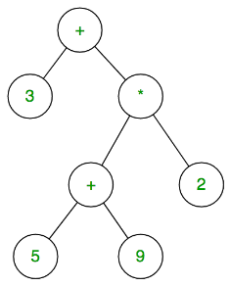
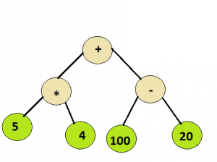
EXAMPLE OF EXPRESSION TREE
View our implementation!

Slide 22
ADVANTAGE & DISADVANTAGE
Efficient Evaluation
Hierarchical Representation
Complex Construction
Limited Applicability

Slide 23
HUFFMAN TREE
Huffman trees are binary trees where each leaf node represents a symbol (like a character) and has an associated frequency.

Slide 24
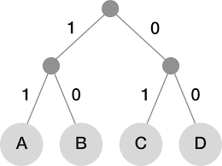
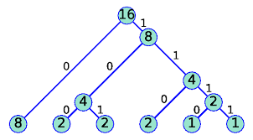
EXAMPLE OF HUFFMAN TREE
View our implementation!

Slide 25
ADVANTAGE & DISADVANTAGE
Efficient Compression
Lossless Compression
Symbol Frequency Dependency

Slide 26
HASHING, HASH TABLE AND HASH FUNCTION
Hashing is the process of converting an input value into a fixed-size output value called a hash value.
Hash Table is a data structure that uses hashing to store key-value pairs while
A hash function is a mathematical function that takes an input (or 'message') and produces a fixed-size string of characters, which is typically a hash value or hash code.

Slide 27
PURPOSE
The purpose of hashing is to generate a hash value that can be used to identify or verify data while
Hash Table is to store and retrieve key-value pairs efficiently
The primary purpose of a hash function is to uniquely represent data in a way that facilitates efficient retrieval, storage, or comparison of information

Slide 28
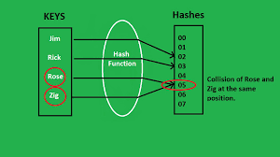
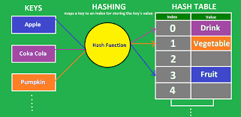
EXAMPLE OF HASHING FUNCTION
View our implementation!

Slide 29
ADVANTAGE AND DISADVANTAGE
Fast Retrieval:
Constant Time Average Case
Collision Handling:
Hash Function Dependency:

